Slide 1


Slide 2
AISHELL & AISHELL Foundation
AISHELL & AISHELL Foundation
卜辉 AISHELL/CEO

Slide 3
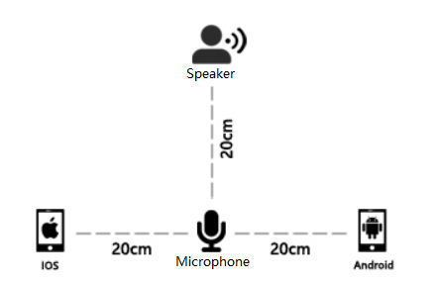
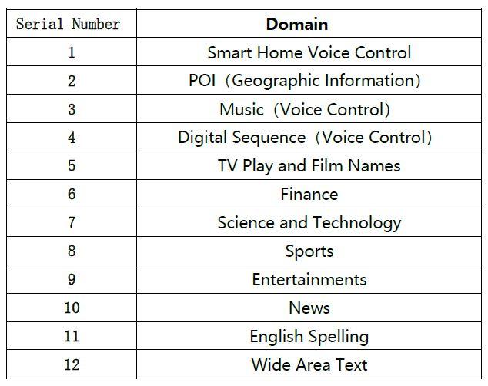
AISHELL-1 & AISHELL-2
AISHELL-1
Kaldi recipe
Kaldi recipe
AISHELL-2
s5: a speech recognition recipe
v1: a speaker recognition recipe
speech recognition recipe
kaldi/egs/aishell2/
http://www.openslr.org/33/
http://www.aishelltech.com/aishell_2
178H
400 Speakers
1000H
1991 Speakers
● Sampling Rate: 16KHz
Sample Format: 16bit
Environment: Indoor
● Sampling Rate: 16KHz
Sample Format: 16bit
Environment: Indoor

Slide 4
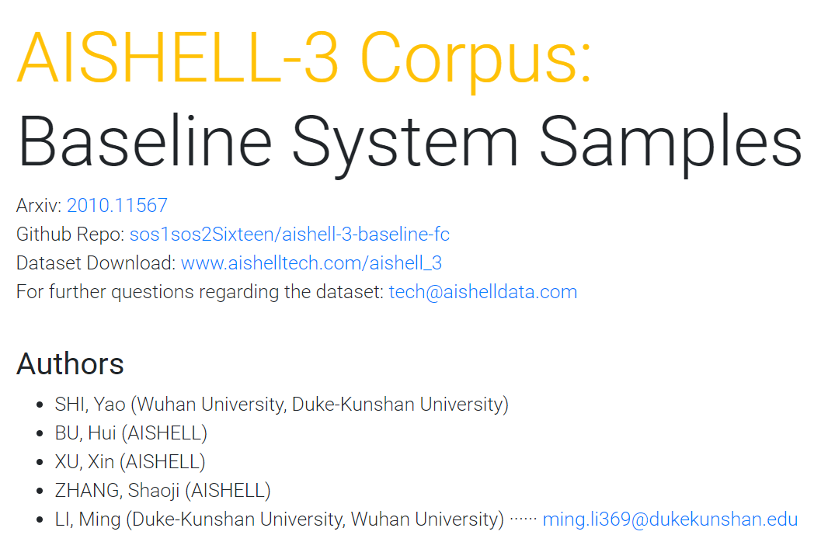
AISHELL-3
AISHELL-3
multi-speaker Text-to-Speech (TTS) systems
● Sampling Rate: 44.1KHz
Sample Format: 16bit
Environment: Indoor
85H
218 Speakers
System recipe
https://sos1sos2sixteen.github.io/aishell3/
Download-Dataset
http://www.aishelltech.com/aishell_3
Download-Paper
https://arxiv.org/abs/2010.11567
Notes:
从CV对比SPEECH的开源库和应用的深度，语音的技术发展，数据必须要开源。技术落地，数据先行

Slide 5
AISHELL-Dataset
AISHELL-1
ASR
AISHELL-2
AISHELL-3
TTS
VPR
AISHELL-1
Notes:
从CV对比SPEECH的开源库和应用的深度，语音的技术发展，数据必须要开源。技术落地，数据先行

Slide 6
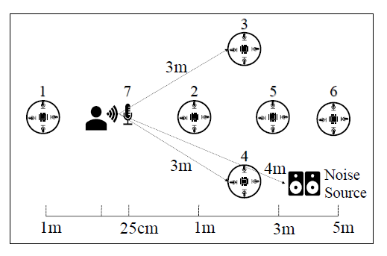
AISHELL-WakeUp-1
Hi-mia
“你好，米雅” “Hi, Mia”
Open Source
AISHELL Speaker Verification Challenge 2019
HI-MIA
http://www.openslr.org/85/
AISHELL-WakeUp-1
http://www.aishelltech.com/wakeup_data
1561H
340 Speakers
Sampling Rate: 44.1KHz & 16KHz
Sample Format: 16bit
Environment: Indoor
Notes:
从CV对比SPEECH的开源库和应用的深度，语音的技术发展，数据必须要开源。技术落地，数据先行

Slide 7

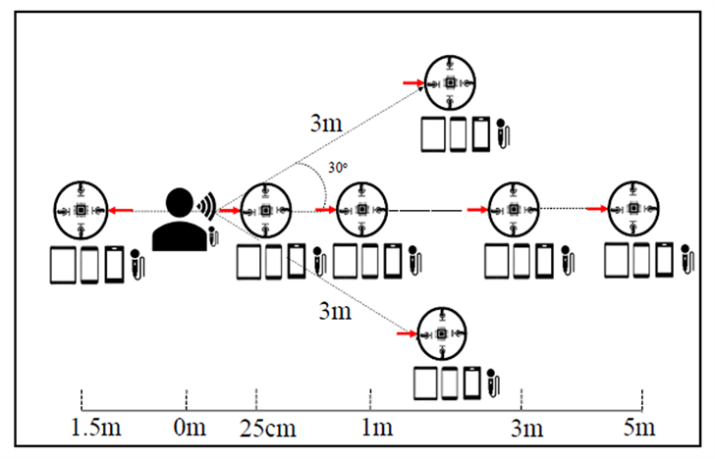


AISHELL-DMASH
dmash
Distributed Microphone Arrays in Smart Home (DMASH) Dataset
Open
Source
The INTERSPEECH 2020
Far-Field Speaker Verification Challenge
http://www.aishelltech.com/DMASH_Dataset
50000H
Sampling Rate: 44.1KHz & 16KHz
Sample Format: 16bit
Environment: Indoor
1
2
3
500 Speakers
Notes:
从CV对比SPEECH的开源库和应用的深度，语音的技术发展，数据必须要开源。技术落地，数据先行

Slide 8


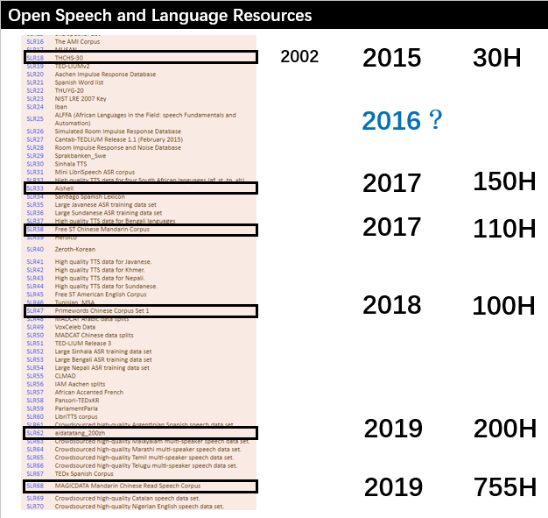
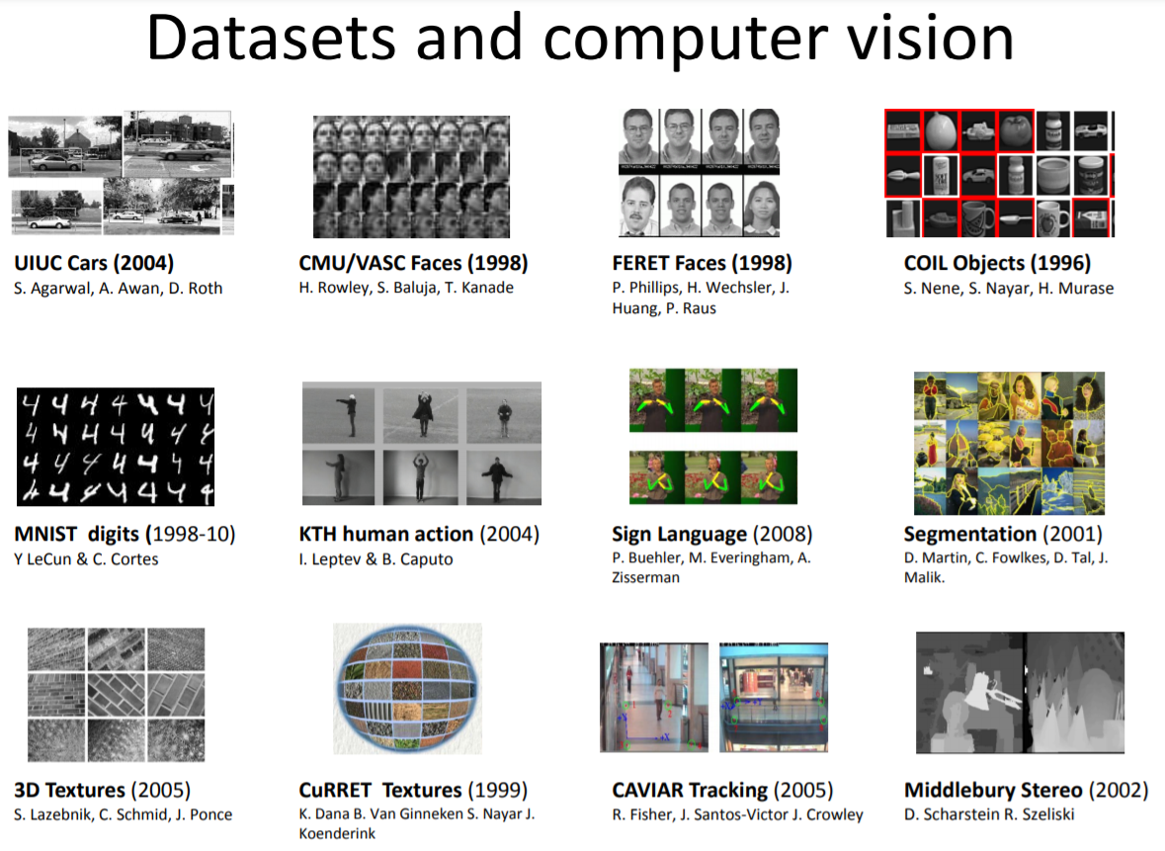
AISHELL-Dataset
开源开放基础数据
更开放的算法、算力、数据环境
发布时间：2009 ～ 2010
1400万的图像
Notes:
从CV对比SPEECH的开源库和应用的深度，语音的技术发展，数据必须要开源。技术落地，数据先行

Slide 9
AISHELL-Dataset
THANKS
AISHELL-1
ASR
AISHELL-2
dmash
AISHELL-3
TTS
VPR
AISHELL-1
?
Hi-mia
Notes:
从CV对比SPEECH的开源库和应用的深度，语音的技术发展，数据必须要开源。技术落地，数据先行

